Slide 1


Executive Post Graduate Certificate in Cloud Computing and DevOps

Slide 2


Course : Cloud Computing
Lecture On : Understanding Core Concepts and Service Models
Instructor: Dr. Chandrashekar Ramanathan
IIIT Bangalore

Slide 3
Today’s Agenda
Jargon Busting
1
What is Cloud Computing?
2
Types of Cloud Services: IaaS, PaaS and SaaS
  Infrastructure as a Service (IaaS)
  Platform as a Service (PaaS)
  Software as a Service (SaaS)
3
Cloud Computing: Advantages and Disadvantages

Slide 4
Some Concepts and Terminologies

Slide 5
Types of Software Systems
Enterprise Systems
Consumer Systems
Engineering Systems
Large scale systems used by multiple people collectively belonging to same organization
Small scale systems used by multiple individuals
Large scale systems used by engineering industry
Large systems, fewer users
Closed-User-Group
Small systems, huge number of users
Open-User-Group
Examples
Shop Floor
Self-Driving Cars
Examples
ERP
CRM
HRMS
Examples
Mobile Apps
Personal Prod

Slide 6
Data Center
Data Centres (DC)
A building or facilities used to house computer systems and associated components, such as telecommunications and storage systems, providing infrastructure for data processing and management
Elements of DC
IT Equipment: Servers, Routers, Switches,
Physical infra: Cooling systems, Racks, Power supply
Utility services: Power, ISP

Slide 7
Deployment Concepts
What is Deployment
  Sophisticated installation of hardware and software
On-Premise Deployment
The installation and operation of software applications on the physical hardware and infrastructure located within an organisation's premises
Off-Premise Deployment
Using a dedicated data-center on rent to make software available to users
Using shared infrastructure

Slide 8
Virtualization Concepts
Virtualization
The process of creating virtual (non-physical) versions of physical hardware
Virtual Machine Software
Software that can allows a single “large” physical computer to be used to run multiple “smaller” computers
Virtual Machine Image
Packaging of virtual elements necessary for VM software to provide the services of a physical computer

Slide 9
Virtualization Concepts (cont.)
Utility Computing
A service provisioning model in which computing resources are provided and billed on a pay-per-use basis, similar to utilities such as electricity or water
Elastic Computing
The ability to automatically scale computing resources up or down based on real-time demand, allowing for efficient and flexible resource management

Slide 10
System Quality Attributes (NFR)
Performance
Ability of the system to provide fast response or high throughput
Scalability
Ability of the system to do more with proportionate increase in resources
Security
Protecting compute, storage and network

Slide 11
Cloud Computing

Slide 12
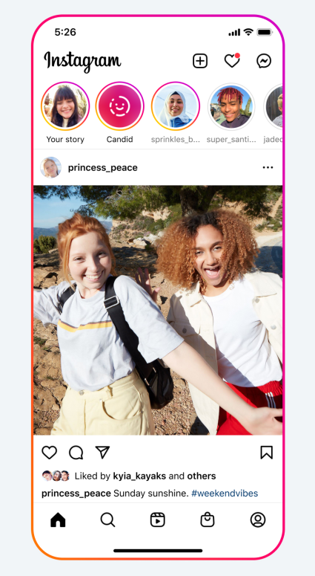
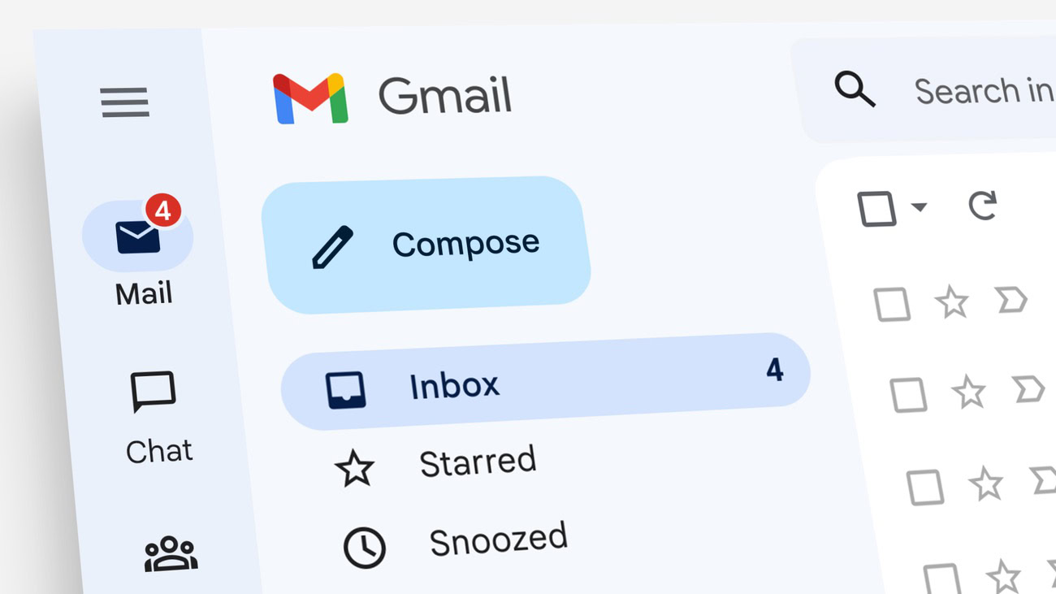

What is Cloud Computing?
Everyday Examples
Checking your Gmail inbox
Watching Netflix shows
Viewing pictures on Instagram feed

Slide 13
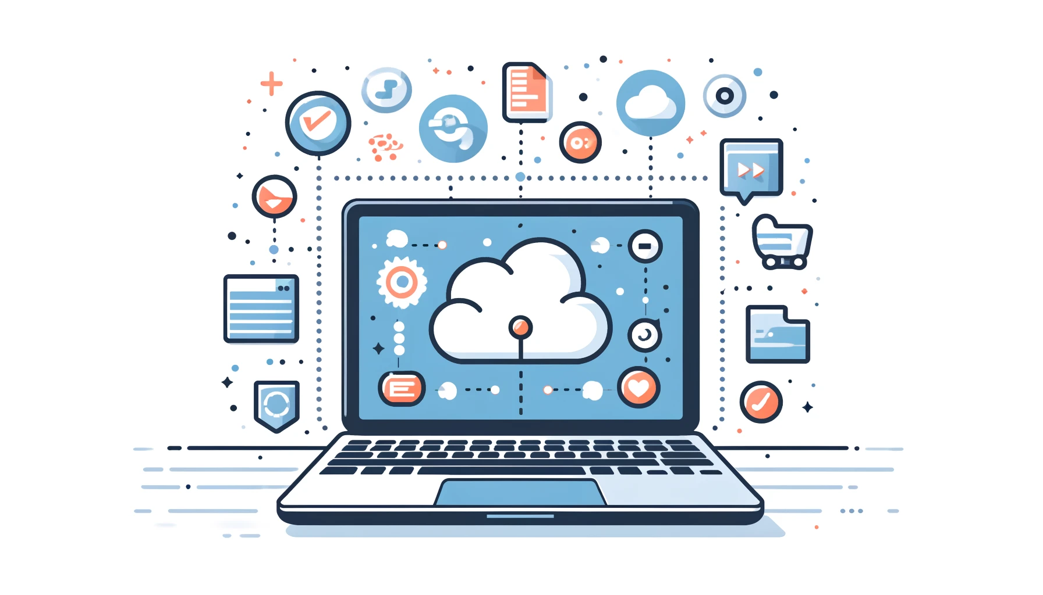
What is Cloud Computing?
When you check your Gmail inbox or scroll through your feed on Instagram, you are accessing information that is located on a server somewhere in the world
Those emails, images, videos or whatever else you need are not being stored on your computer, but you can access them quickly, easily and cheaply owing to modern cloud computing technology

Slide 14
What is Cloud Computing?
A company uses Gmail for their email services instead of setting up their own email servers and software. They do not have to invest heavily in databases, email software and hardware
This allows the company to rent their infrastructure instead of buying it
Gmail provides on-demand access to computing resources over the internet with pay-per-use pricing
This example illustrates how cloud computing offers flexible, scalable and cost-effective solutions for businesses
Definition
Cloud computing is the on-demand access of computing resources - physical servers or virtual servers, data storage, networking capabilities, application development tools, software, AI-powered analytic tools and more - over the internet (the cloud) with pay-per-use pricing

Slide 15
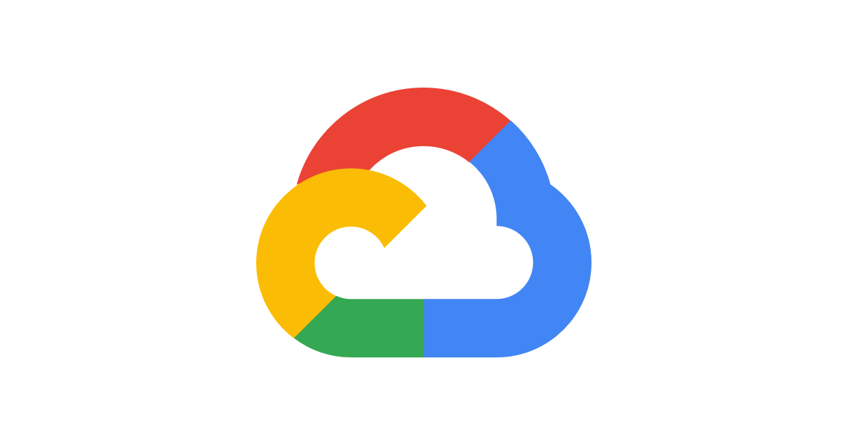
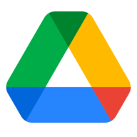
Cloud Computing: Key Characteristics
On-Demand Self-Service
  Using Google Cloud Platform (GCP), users can easily requisition new virtual machines or scale existing resources as needed
Broad Network Access
  Google Drive provides globally-distributed storage, enabling users to access their files from anywhere in the world using various devices
  Cloud services are accessible over the internet from multiple devices, offering strategic provisioning of location-targeted hardware

Slide 16
Cloud Computing: Key Characteristics
Resource Pooling
  Google Cloud uses a shared pool of computing resources that are dynamically allocated to different users based on demand
  Shared resources for multiple users
Rapid Elasticity
  Google Cloud’s auto-scaling feature dynamically adjusts computing power for applications such as Google Search based on traffic demands
  Cloud infrastructures can grow and shrink dynamically, allowing users to request auto-scaling of resources with traffic demands. Scalability can occur on a single machine or across multiple machines
Measured Service
  Cloud computing operates on a pay-per-use pricing model, ensuring users pay only for the resources they consume

Slide 17
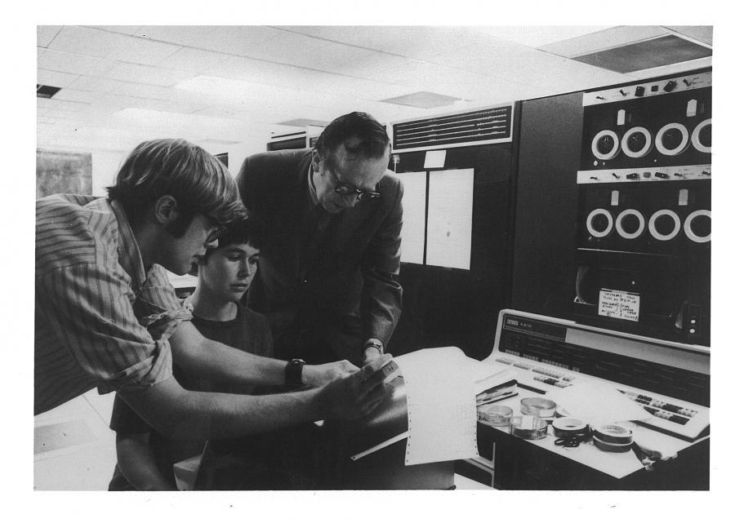
Historical Context and Evolution
Early Concepts
In 1960s, Dr Joseph Carl Robnett Licklider, an American computer scientist and psychologist known as the ‘father of cloud computing’, introduced the idea of global networking
Proposed the Intergalactic Computer Network, envisioning a world where everyone could access information from anywhere via interconnected computers

Slide 18
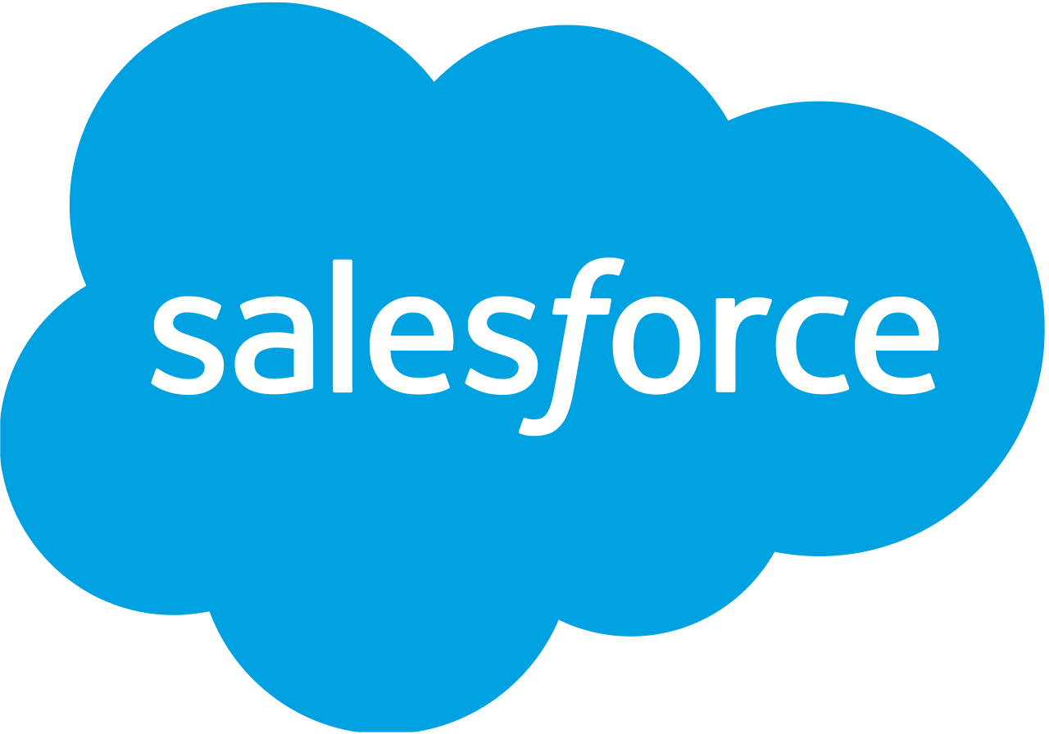



Historical Context and Evolution
Cloud Computing: Emergence
Salesforce (1999)
  Pioneered the concept of delivering enterprise
  applications via a simple website
Amazon Web Services (2002)
  Started cloud-based storage and computing services
  Introduced Elastic Compute Cloud (EC2) in 2006 for renting virtual computers
Google (2006)
  Launched Google Apps suite (now Google Workspace), a collection of SaaS productivity apps
Microsoft (2010)
  Launched Windows Azure
  Entered SaaS market with Office 365 in 2011

Slide 19

Historical Context and Evolution
Cloud Computing: Emergence
Cloud Growth in 2020
  IaaS spending: $37 billion in Q4, $130 billion for 2020 (35% increase)
  Data centre hardware/software spending fell 6% to <$90 billion
2020-2021 Trends
  Cloud enterprise spending grew 43% in 2020 and 29% in 2021 to $81 billion
Predictions
  By 2024, 45% of IT spending will shift from internal infrastructure to cloud services

Slide 20
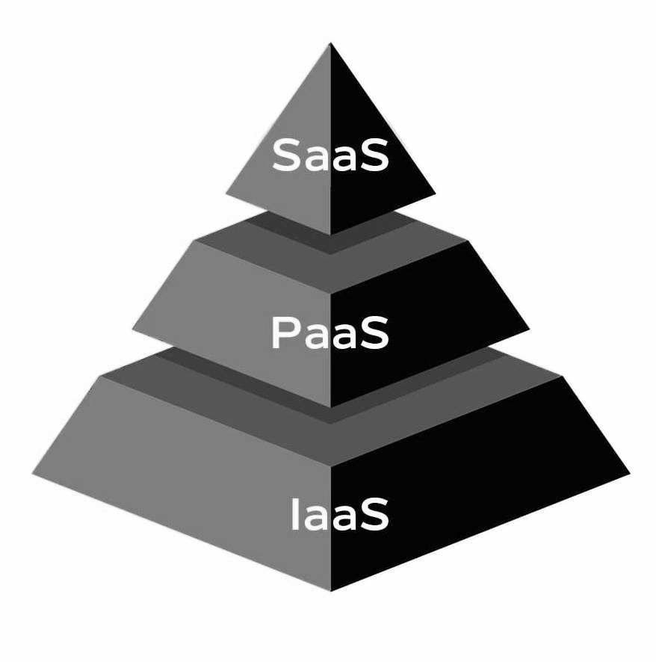
Types of Cloud Services
Service Models: Introduction
These services provide customers with varying levels of control and responsibility in their cloud environment
There is no one-size-fits-all approach to cloud. It is common for an organisation to use some combination of all

Slide 21
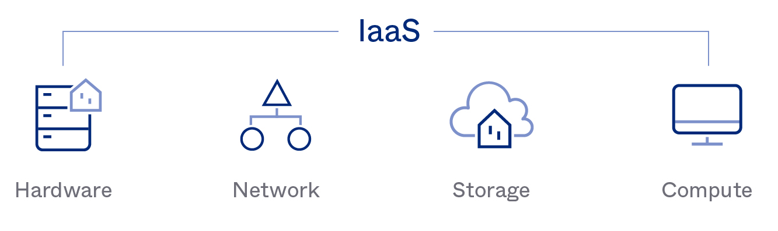
Infrastructure as a Service (IaaS)
Google Cloud Platform (GCP) provides a comprehensive suite of cloud services that allow businesses to rent IT infrastructure, including servers, networks, storage and operating systems

Slide 22
Infrastructure as a Service (IaaS)
Scale and shrink resources as needed: With GCP, companies can dynamically adjust their resource usage based on demand, ensuring optimal performance and cost efficiency
Reduces the need for high up-front capital expenditures: By leveraging GCP's pay-as-you-go model, businesses avoid the need for significant initial investments in hardware and infrastructure
Avoids overbuying resources for periodic spikes: GCP's elastic scalability allows businesses to handle traffic spikes without overcommitting to permanent resources
Other examples of IaaS providers: Amazon Web Services (AWS), Microsoft Azure

Slide 23
IaaS: Key Features and Use Cases
Specialised Tasks
  Reserve pre-configured machines for load balancers, databases, email servers and distributed queues
‘Lift and shift’ strategy : Migrate data and applications to the cloud (e.g. small businesses moving file, email and web servers)
Disaster Recovery
  Store redundant backups across multiple data centres
  Ensure data recovery in case of ransom, deletion or natural disasters
Build DevOps toolchains using IaaS with various third-party tools

Slide 24
Platform as a Service (PaaS)
Definition
  Provides resources for building user-level tools and applications
  Service provider manages infrastructure and middleware
  Customer responsibility is to manage own data and software
Benefits
  No worries about software updates, operating systems or storage
  Pay for consumed computing resources
Examples
  Google App Engine
  SAP Cloud

Slide 25
PaaS: Key Features and Use Cases
Access to tools for building and managing mobile and web applications without infrastructure investment
Container-Based Architecture
  Built around containers, one step removed from virtual servers
  Containers virtualize the OS, allowing application packaging without middleware
Example: Red Hat OpenShift
  Built around Docker containers and Kubernetes
  Automates deployment, scaling, load balancing and more for container-based apps

Slide 26
Software as a Service (SaaS)
Definition
  Provides on-demand software applications hosted and managed by cloud providers
  Providers handle software upgrades and security patching
Benefits
  Customers purchase licenses to use hosted applications, eliminating the need for maintaining computing infrastructure
Examples
  Microsoft 365
  Google Workspace

Slide 27
SaaS: Key Features and Use Cases
Quick deployment : Ideal for businesses to swiftly adopt innovative technology
Scalability : Customers can scale services to support fluctuating workloads
Additional Benefits
  Automatic upgrades : New features added seamlessly by the service provider
  Data loss protection : Application data stored in the cloud prevents loss in the case of device failure
Suitability for Small Businesses
  Cost and resource-effective solution for small businesses lacking IT infrastructure

Slide 28
Cloud Computing: Advantages
Cost Efficiency
  Reduced capital expenditures
  Beyond hardware costs, cloud providers do their best to maximise and optimise hardware usage
Scalability and Flexibility
  On-demand resource scaling
  Cloud applications can automatically shrink and grow their infrastructure resources in response to spikes of traffic
Increased Security
  Advanced security features such as isolated firewalled infrastructure
  User access control is an important security concern, and most cloud providers offer tools to limit granular user access

Slide 29
Cloud Computing: Advantages
Accessibility and Mobility
  Access from anywhere, ensuring productivity regardless of location, facilitating consistent user experience across multiple offices
Disaster Recovery and Data Backup
  Redundant backups and quick recovery minimise downtime
  Virtual servers offer flexibility, relocating efficiently to different data centres within minutes
Increased Speed and Agility
  Cloud computing enables rapid deployment of enterprise applications, reducing wait times
  DevOps and development teams leverage cloud-based software and infrastructure, accelerating product development and deployment cycles

Slide 30
Cloud Computing: Disadvantages
Downtime and Reliability Issues
  Potential service disruptions due to natural disasters or technical issues affecting connectivity
  Possible blockage from accessing cloud services until issues are resolved, despite high availability guarantees
Security and Privacy Concerns
  Risks of external data storage
  Inadequate security measures may lead to data leakage, intellectual property theft, breaches and malware attacks

Slide 31
Cloud Computing: Disadvantages
Limited Control and Flexibility
  Cloud infrastructure entirely owned, managed and monitored by the provider
  End-user license agreements and management policies may impose deployment limitations
Vendor Lock-in
  Migration challenges between providers
  Differences in platforms may lead to additional costs and configuration complexities
Cost Concerns
  Potential for unexpected expenses
  Perception of expense when adopting cloud solutions for small-scale or short-term projects

Slide 32
Summary and Key Takeaways
1
Cloud Computing Concepts : Overview
Definition and basic concepts : Cloud computing is the on-demand access to various computing resources over the internet, allowing users to rent instead of buying IT infrastructure and services
Key characteristics : Cloud computing is defined by its on-demand self-service, broad network access, resource pooling, rapid elasticity and measured service

Slide 33
Summary and Key Takeaways
2
Cloud Services : Types
Infrastructure as a Service (IaaS): Provides virtualized computing resources over the internet, such as AWS and Microsoft Azure, ideal for scalable and flexible IT infrastructure
Platform as a Service (PaaS): Offers hardware and software tools over the internet, such as Google App Engine, enabling developers to build and deploy applications without managing the underlying infrastructure
Software as a Service (SaaS): Delivers software applications over the internet on a subscription basis, including Microsoft 365 and Google Workspace, allowing users to access software without managing installations and updates

Slide 34
Summary and Key Takeaways
3
Cloud Computing : Advantages
Cost efficiency : Reduces the need for large capital expenditures by allowing pay-per-use pricing models
Scalability and flexibility : Enables businesses to scale resources according to demand
Increased security : Offers advanced security features and disaster recovery options
Accessibility and mobility : Provides access to data and applications from anywhere, enhancing productivity
Disaster recovery and data backup : Ensures data redundancy and quick recovery times

Slide 35
Summary and Key Takeaways
4
Cloud Computing : Disadvantages
Downtime and reliability issues : Potential for service disruptions that can affect business operations
Security and privacy concerns : Risks associated with storing sensitive data on external servers
Limited control and flexibility : Reduced control over certain aspects of the infrastructure
Vendor lock-in : Challenges associated with migrating between different cloud providers
Cost concerns : Potential for higher-than-expected costs, especially for small-scale or short-term projects

Slide 36
Questions and Discussions

Slide 37
Thank You!

